Slide 1
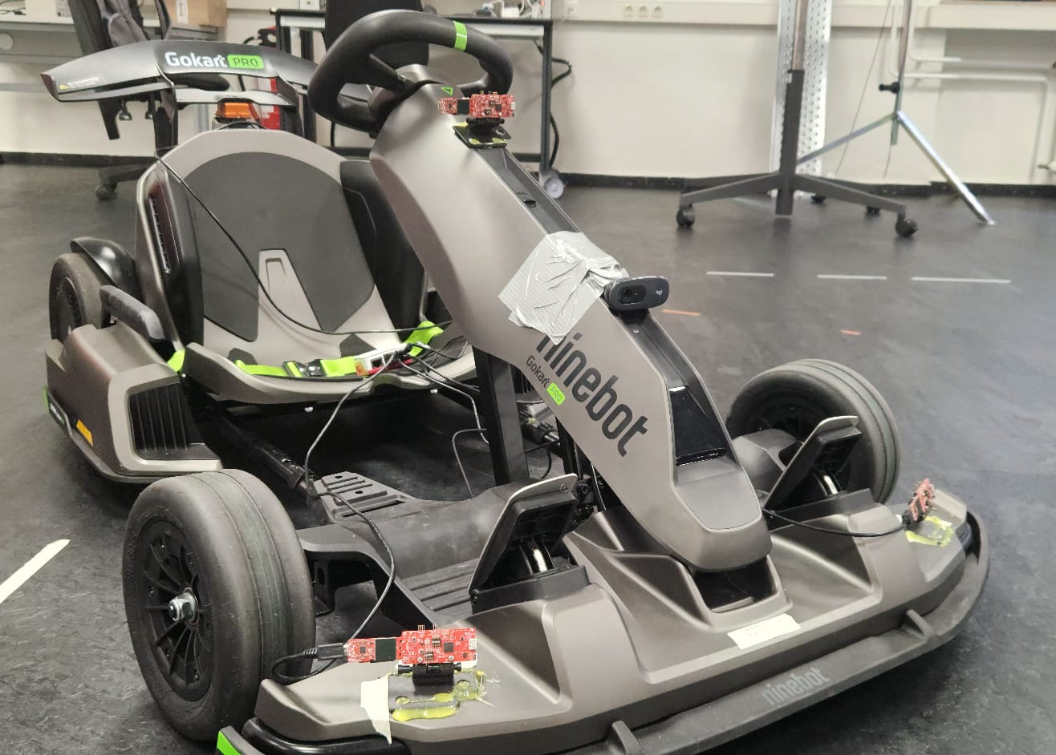
Radar odometry using mmWave technology for SLAM applications.
Radar-based Ego-Motion Estimation.
Author:
Luis Fernando Rodriguez Gutierrez
Supervisor:
Prof. Dr. Andreas Becker
Co-Supervisor:
Tobias Uhlich
Fig 1, Test vehicle representation.

Slide 2
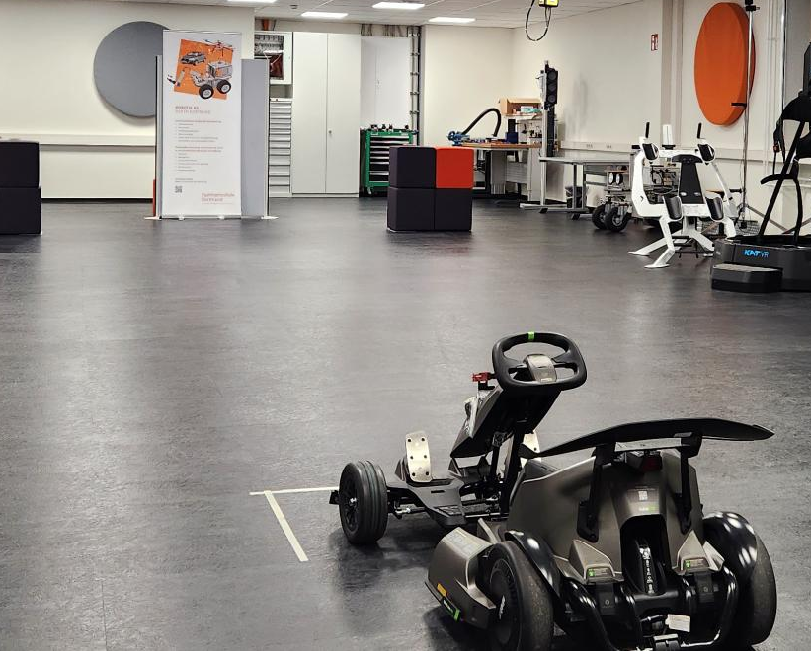
Project Overview
This project investigates radar-based ego-motion estimations using mmWave sensors and inertial measurements units (IMU) as foundation for autonomous navigation and SLAM.
The focus is on deriving vehicle motion (translation and rotation) from sparse point clouds, enhanced by Doppler and IMU data. This while keeping compute and sensor cost practical for embedded use.
Fig 2, Laboratory scenario with test vehicle.
Notes:
We aim for odometry first. SLAM is a later application

Slide 3
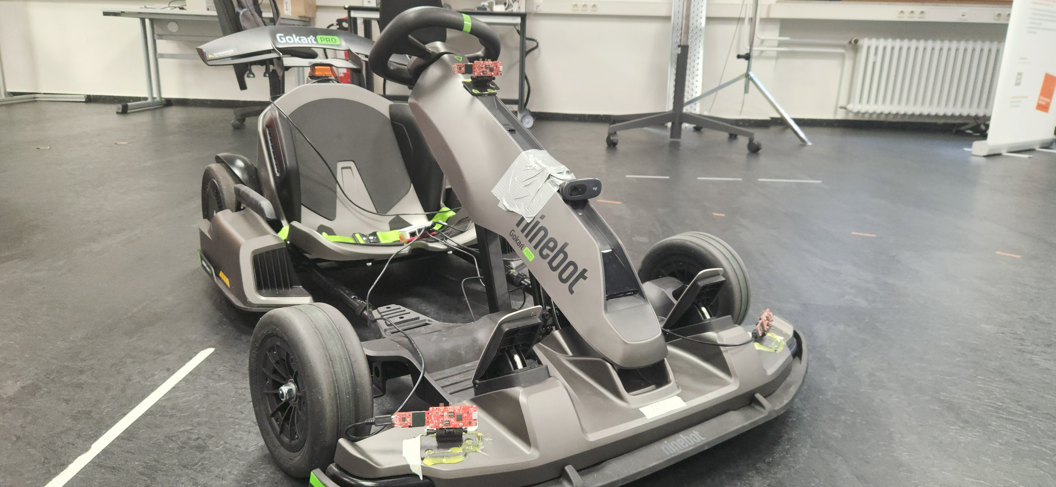
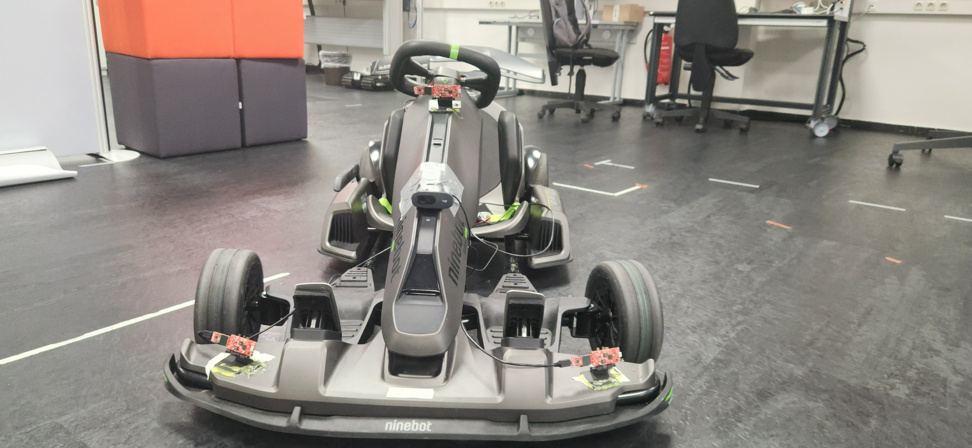
Project Overview Vehicle
Ninebot Gokart PRO
Max. Speed: 40 km/h.
Max Distance: 25 km.
Max Acceleration: 1,02 G.
Drift-Assistance System.
Fig 3.a, Diagonal view of test vehicle.
Fig 3.b, Front view of test vehicle.

Slide 4
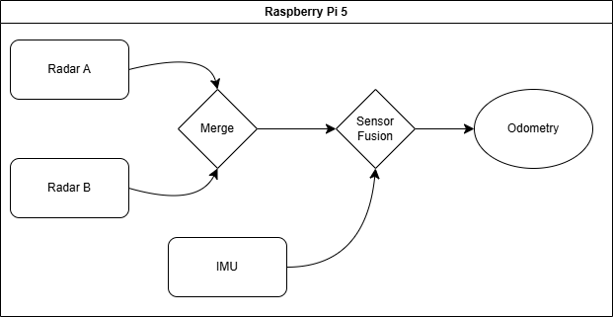
Project Overview System visual representation
Fig 4, System representation to achieve odometry.

Slide 5
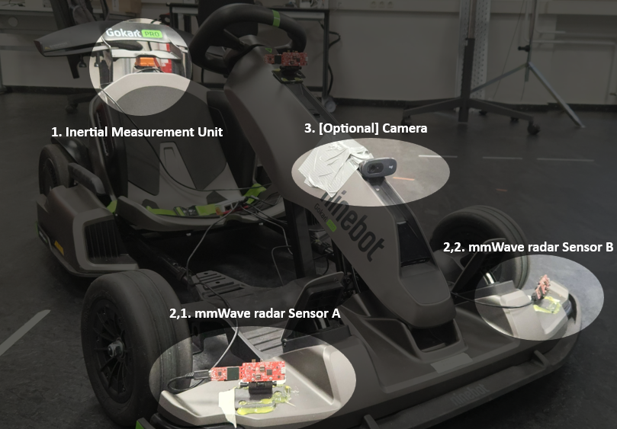
Hardware Setup
Sensors used for the project:
MTi-710, Inertial Measurement Unit.
IWR6843AOP, mmWave radar sensor.
Logitech C270 HD, Camera.
Fig 5, Test Vehicle mounted modules highlight for visual aid.

Slide 6
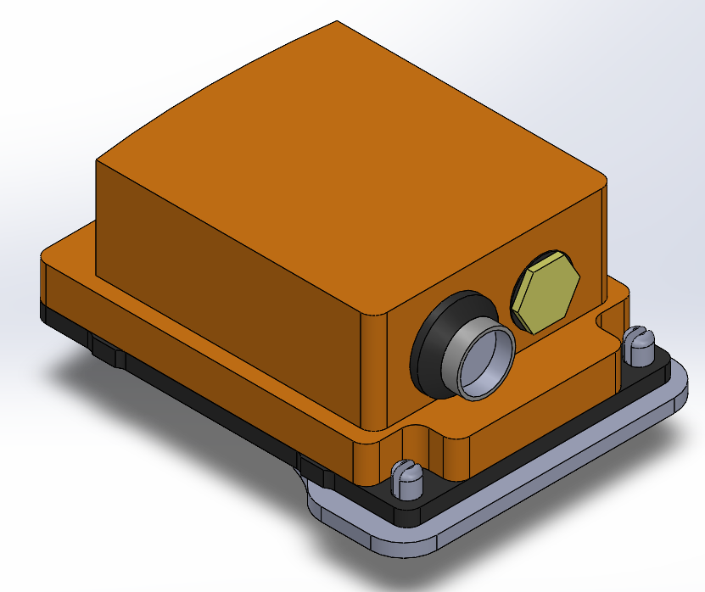
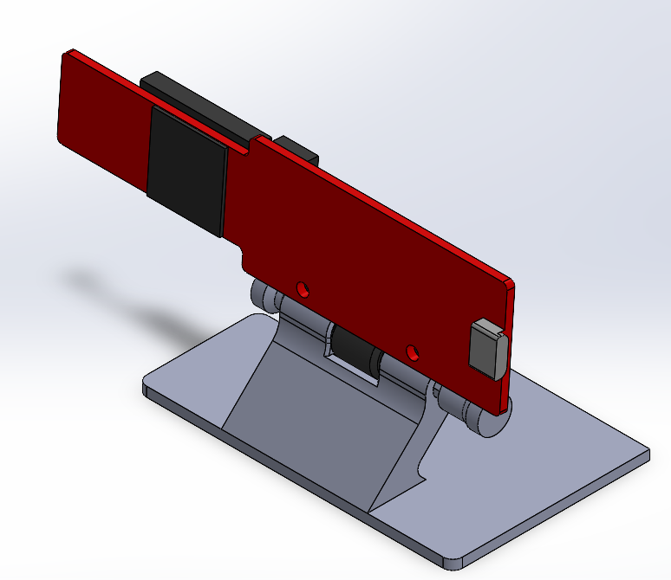
Hardware Setup 3D Modeling
To securely integrate the sensors into the vehicle, custom 3D-printed mounts were designed.
Each mount ensures an optimal alignment and positioning of the sensors to maintain consistent measurement geometry.
The models were developed in CAD to ensure the following points:
MTi-710, ensure close to no tilt to the sensor to avoid post processing.
IWR6843AOP, ensure stability when mounted and possibility to tilt the sensor to modify the field of view.
Fig 6, Inertial Measurement Unit
3D model.
Fig 7, mmWave IWR6843 AOP
3D model.

Slide 7
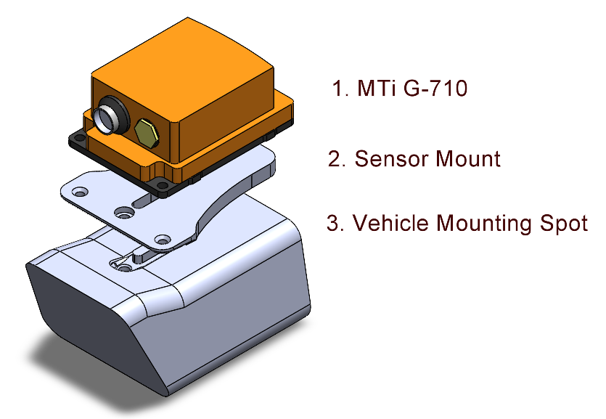
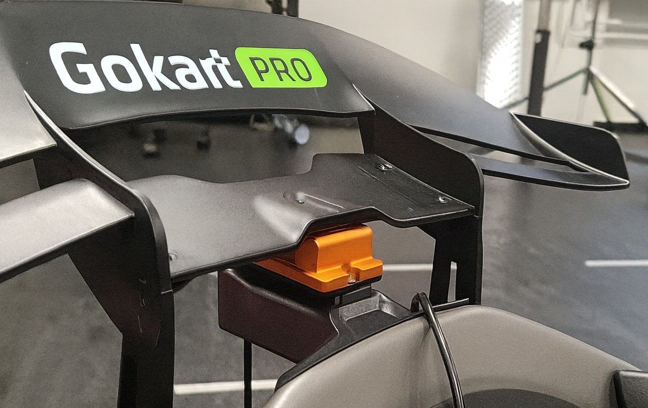
Hardware Setup MTi-710
The integration of the IMU was an interesting one. As the nature of the IMU is to measure the inertia and rotation, the mounting of this sensor is crucial. Depending on the position a post-processing needs to be done to ensure accurate measurements or place it in an “ideal” position. For this vehicle, the ideal place was found, however it needed a unique mount for the vehicle.
Fig 8, IMU mounting system visualization.
Fig 9, IMU mounted in the test vehicle.

Slide 8
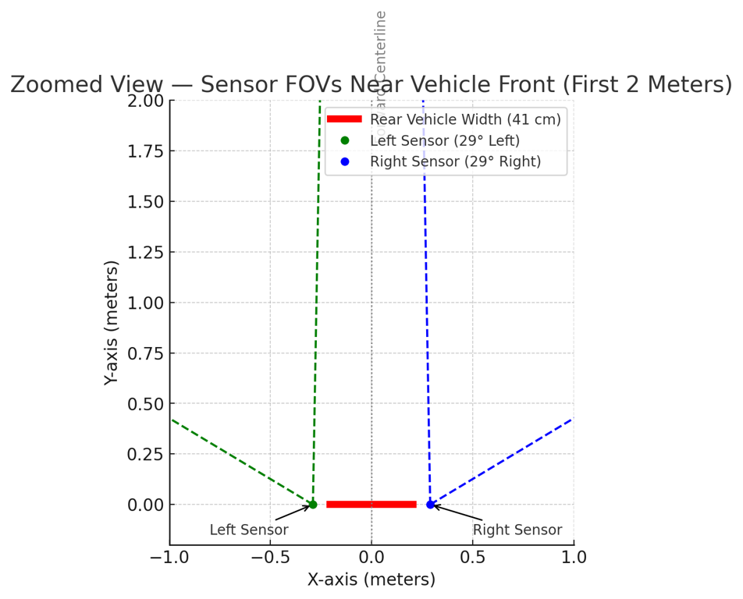
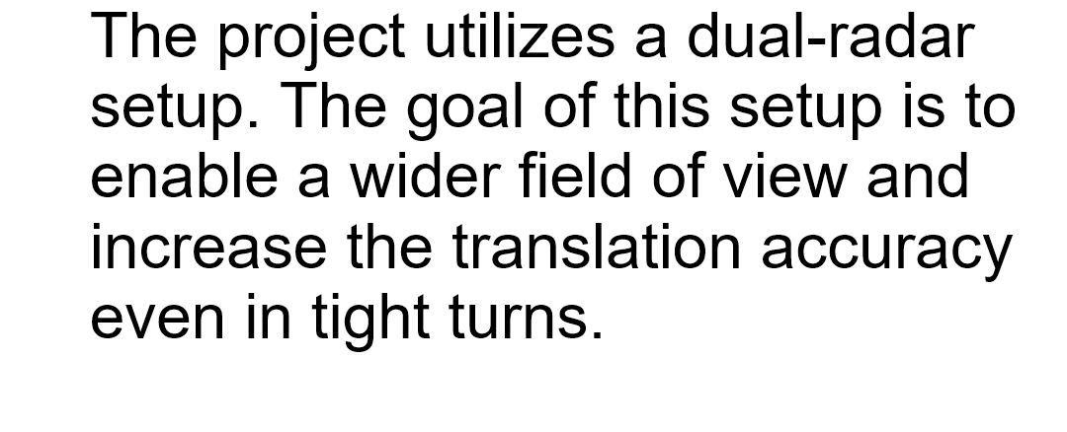
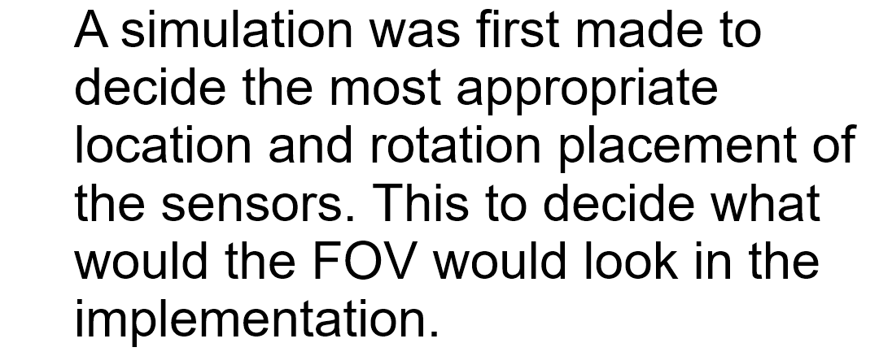
Hardware Setup IWR6843AOP
Fig 10, mmWave sensors mounting orientation
simulation.

Slide 9
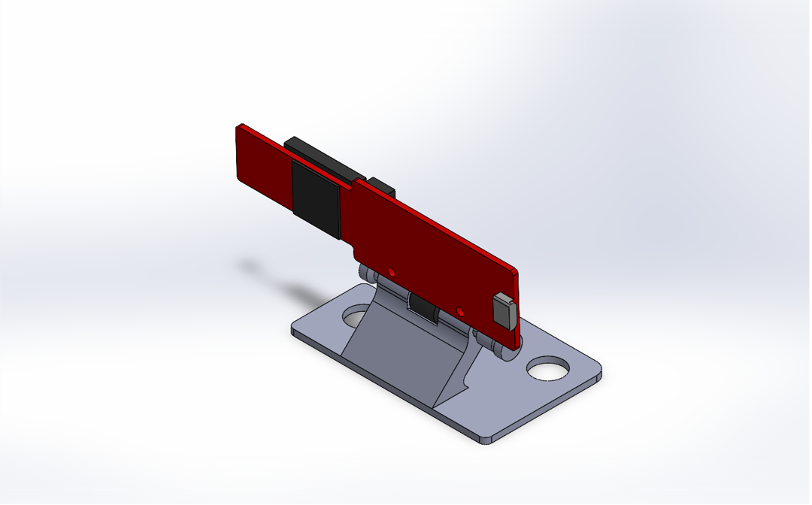
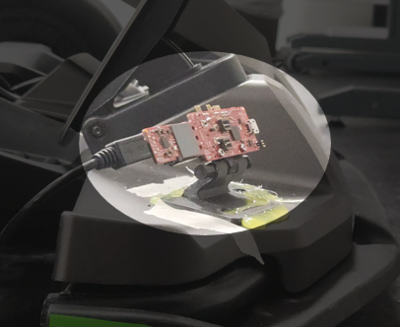
Hardware Setup IWR6843AOP
The radar modules were mounted with a 58 cm baseline along the vehicle’s X-axis to maximize the field of view.
Each sensor was tilted 15° upward to avoid as much clutter as possible from the ground and rotated outward 30° to expand the azimuth coverage.
Fig 7, mmWave IWR6843 AOP
3D model.
Fig 11, mmWave sensor mounted in the test vehicle.

Slide 10
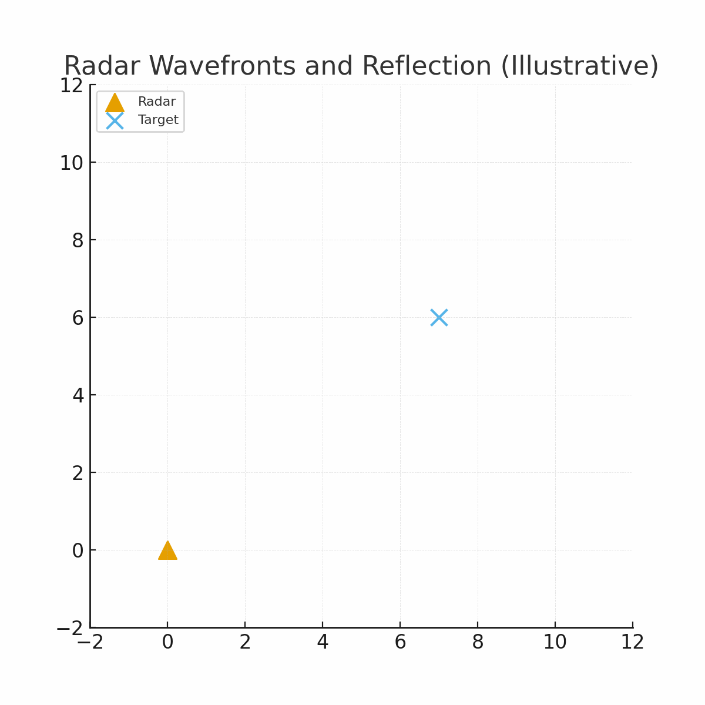
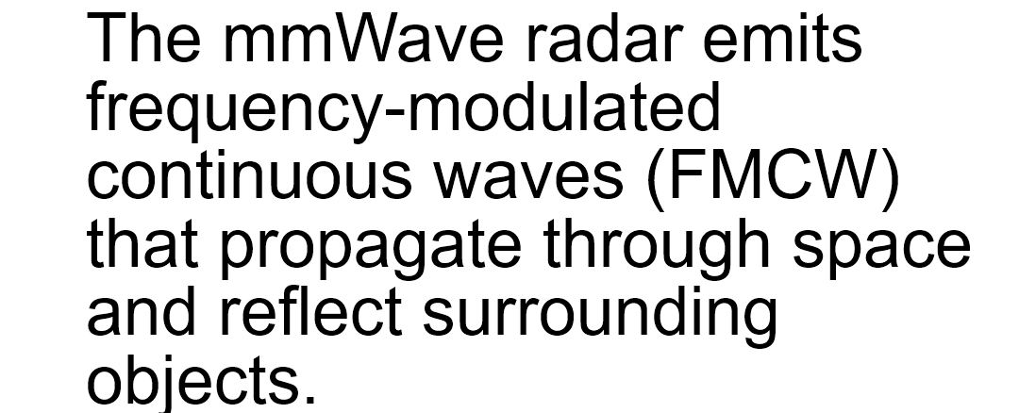
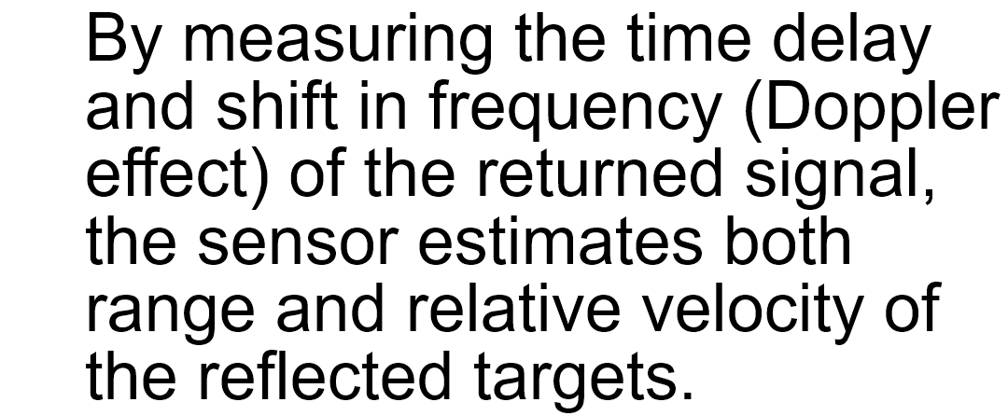
IWR6843AOP Understanding how IWR6843AOP works
Animation 1, Showcase of radar waves bouncing of a target.

Slide 11
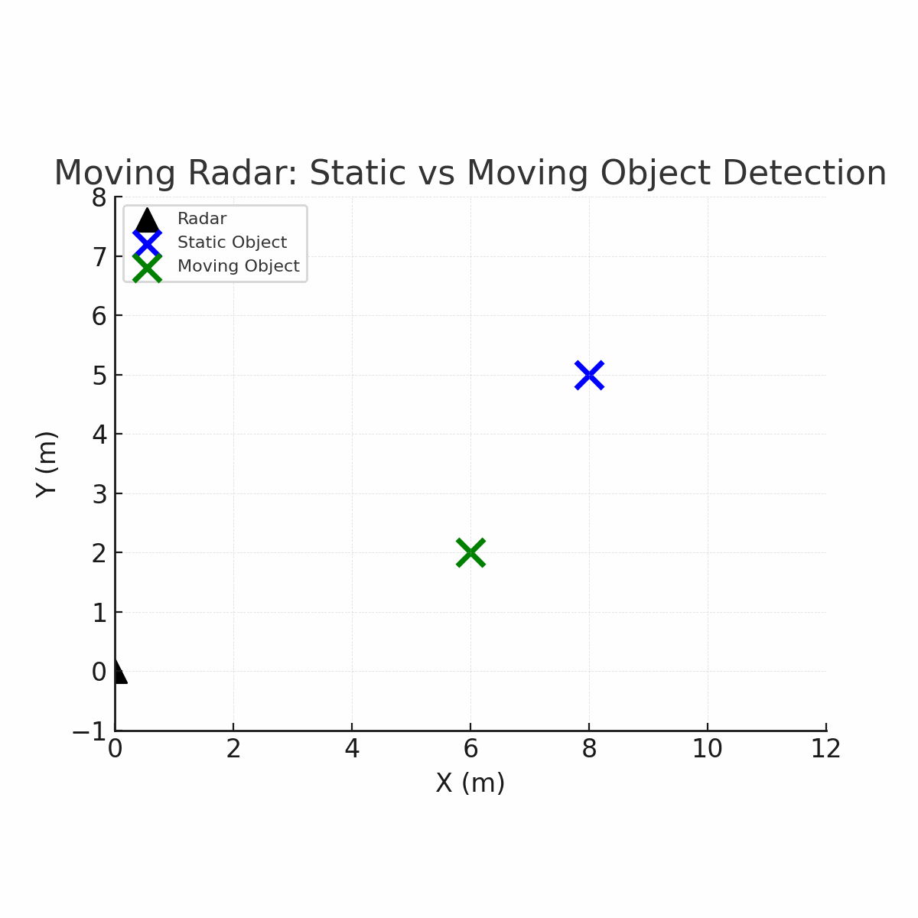
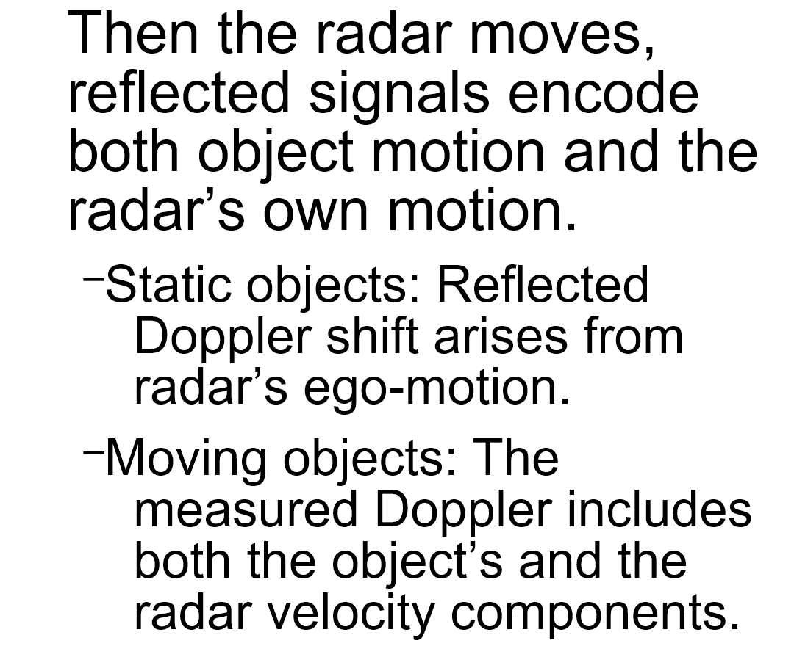
IWR6843AOP Static and Dynamic Objects
Animation 2, Showcase of radar waves hitting a target while radar is moving.

Slide 12
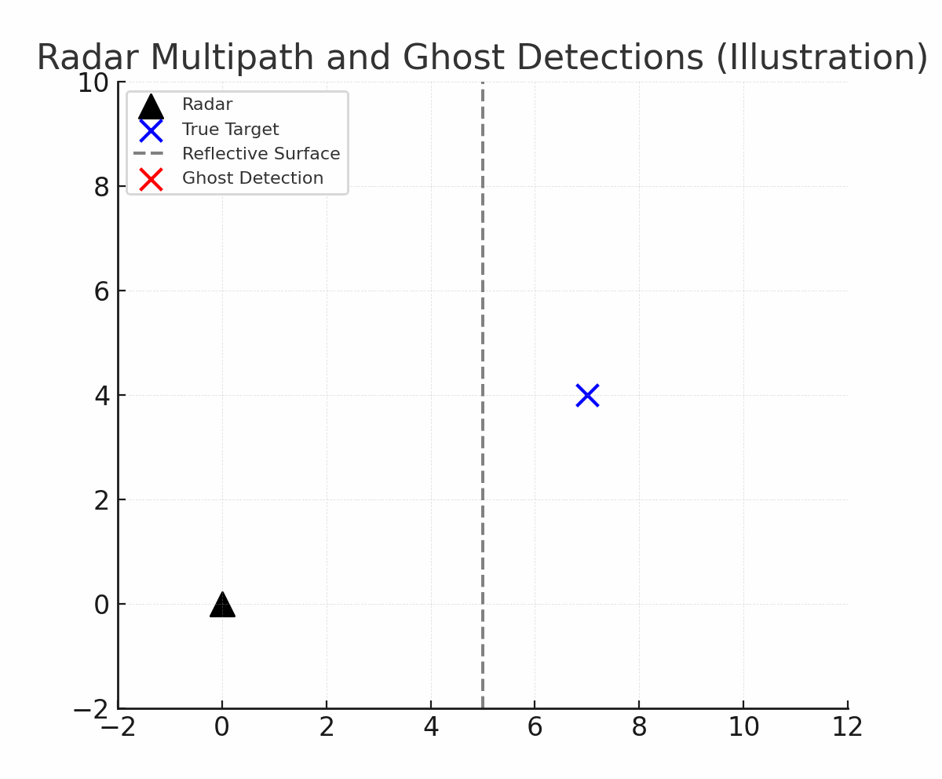
Problem Definition. Limitations of Radar for Odometry.
Sparse point clouds.
Radar detects only a few reflections per computed frame. Meaning weak geometric of non reflective material will not be easily detected.
Multipath and clutter.
Indirect reflections from metallic or smooth surfaces create ghost points or unreliable doppler detections.
Measurement noise.
Low SNR and range quantization cause unstable point locations and Doppler outliers.
Dynamic scenes.
Moving objects introduce inconsistent detentions between frames.
Animation 3, Showcasing of “Ghost Detections”.

Slide 13
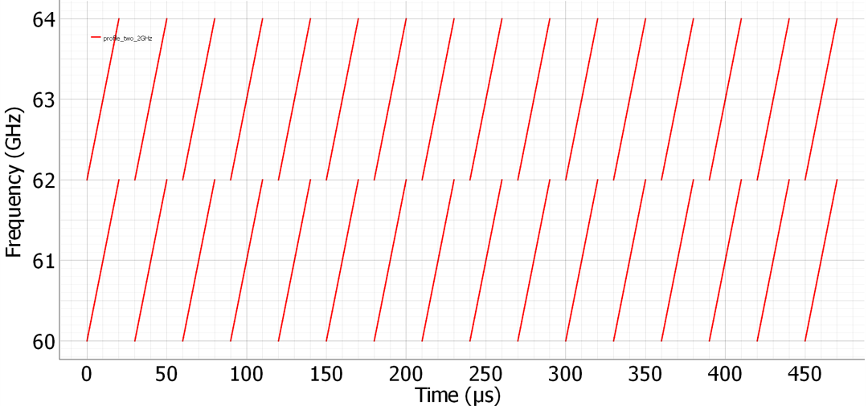
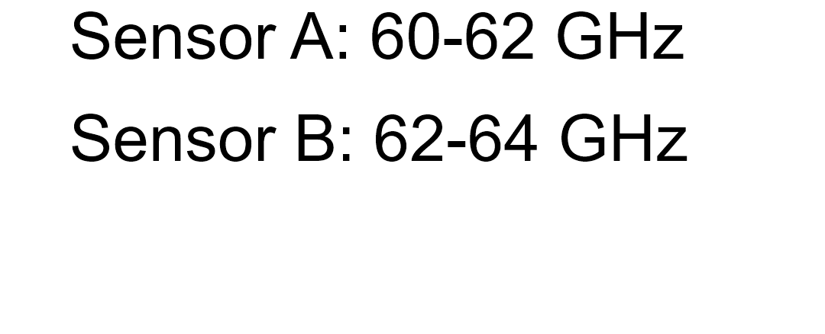
Problem Approach. Limitation of a Dual-Radar setup.
To avoid the multipath of “ghost detections” when using 2 radars a simple solution is often used, such as using different frequencies in each sensors.
Fig 12, Radar frequency instrumentation to avoid collitions when using a two-system radar.

Slide 14
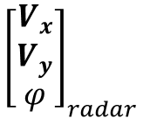
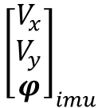
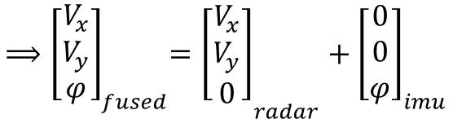
Problem Approach. Translation and Rotation.
Why mmWave + IMU?
Environmental robustness: Operates reliably under adverse conditions, such as rain.
Doppler advantage: Directly measures radial velocity, reducing ambiguity in motion estimation.
Inertial support: IMU provides pose estimates complementing radar’s data.
Combined benefit:
Radar provides accurate translation.
IMU provides consistent rotation.
and
Eq 1, Radar available
information.
Eq 2, IMU available
information.
Eq 3, System instrumentation of sensor fusion to use the best out of both sensors.

Slide 15
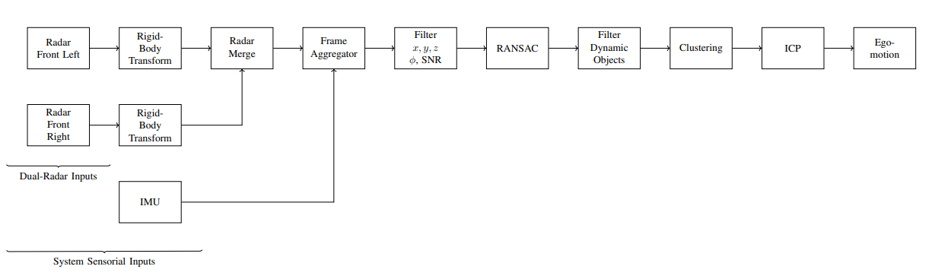
Method Overview Pipeline
Fig 13, Pipeline showcase of the implemented system.

Slide 16
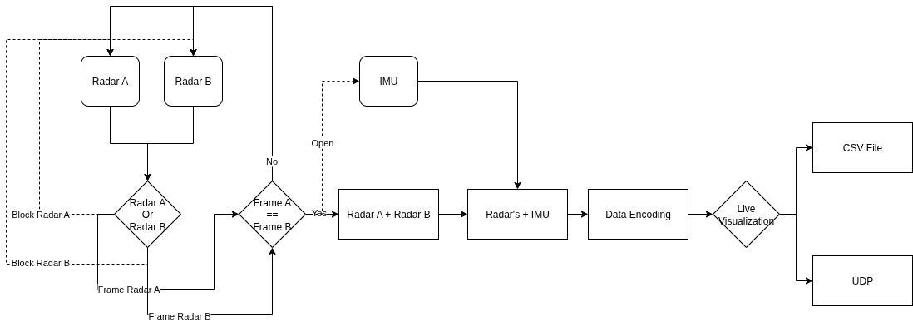
Method Overview Pipeline Code Implementation
Fig 14, Implementation of the code diagram to illustrate the overall system.

Slide 17
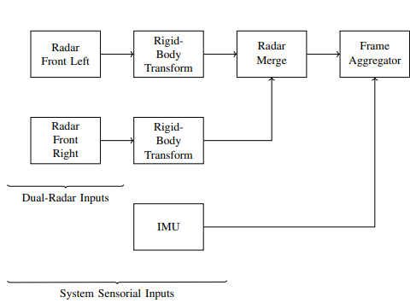
Method Overview Preprocessing and Sensor Fusion
Rigid-Body Transform: Converts each radar’s local coordinates into the vehicle frame.
Radar Merge: Combines both sensors into one unified point cloud.
IMU Integration: Provides angular rate φ and orientation for frame-to-frame alignment.
Frame Aggregation: Build submaps (Q).
Around 10 frames improve spatial sparsity.
Fig 15, Highlight of the pipeline data acquisition and data processing.

Slide 18
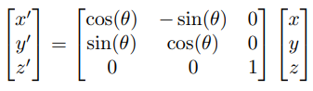
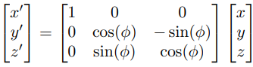
Method Overview Preprocessing and Sensor Fusion
Yaw Transform:
Pitch Transform:
Eq 4, Yaw transformation required for the correction of the acquired data.
Eq 5, Pitch transformation required for the correction of the acquired data.

Slide 19
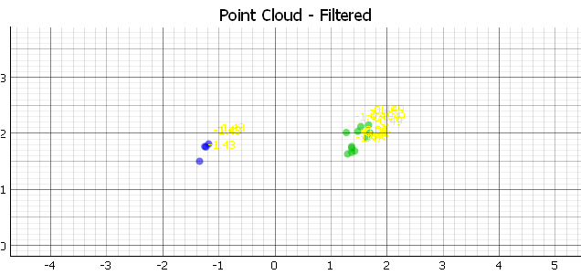
Method Overview Preprocessing and Sensor Fusion
Fig 16, Dual-radar point cloud before the required transforms.

Slide 20
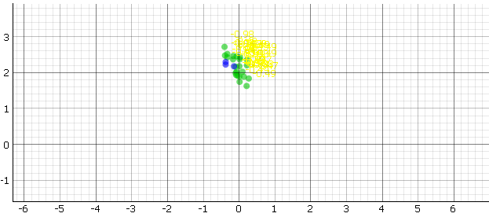
Method Overview Preprocessing and Sensor Fusion
Fig 17, Dual-radar system after the required transforms.

Slide 21
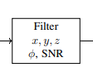
Method Overview Filtering Point Selection
Removal of invalid spatial values and low-SNR points.
Cartesian Coordinate
SNR Filter
Fig 18, Highlight of the pipeline data physical filtering process.

Slide 22
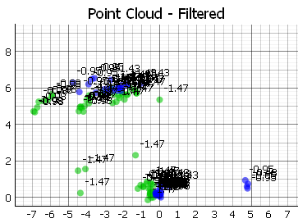
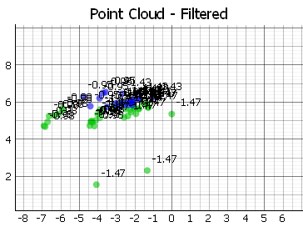
Method Overview Filtering Point Selection
Fig 19.a, Unfiltered data from the point cloud
Fig 19.b, Filtered data from the point cloud
Fig 19, Showcase on how filtering using the physical properties can affect the quality of the available data.

Slide 23
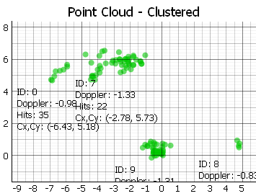
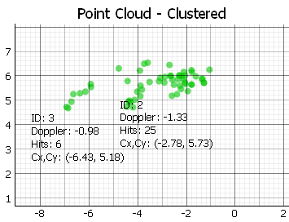
Method Overview Filtering Point Selection
Fig 20.a, Unfiltered data from the point cloud
Fig 20.b, Filtered data from the point cloud
Fig 20, Showcase on the clustered data on how filtering using the physical properties can affect the quality of the available data.

Slide 24
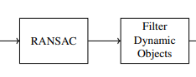
Method Overview Robust Point Selection
RANSAC: Reject outliers by fitting a consistent motion model to radar points.
Dynamic Object Filter: Uses Doppler analysis from the RANSAC model to detect outliers that match moving objects.
Fig 21, Highlight of the pipeline RANSAC and filter of moving objects

Slide 25
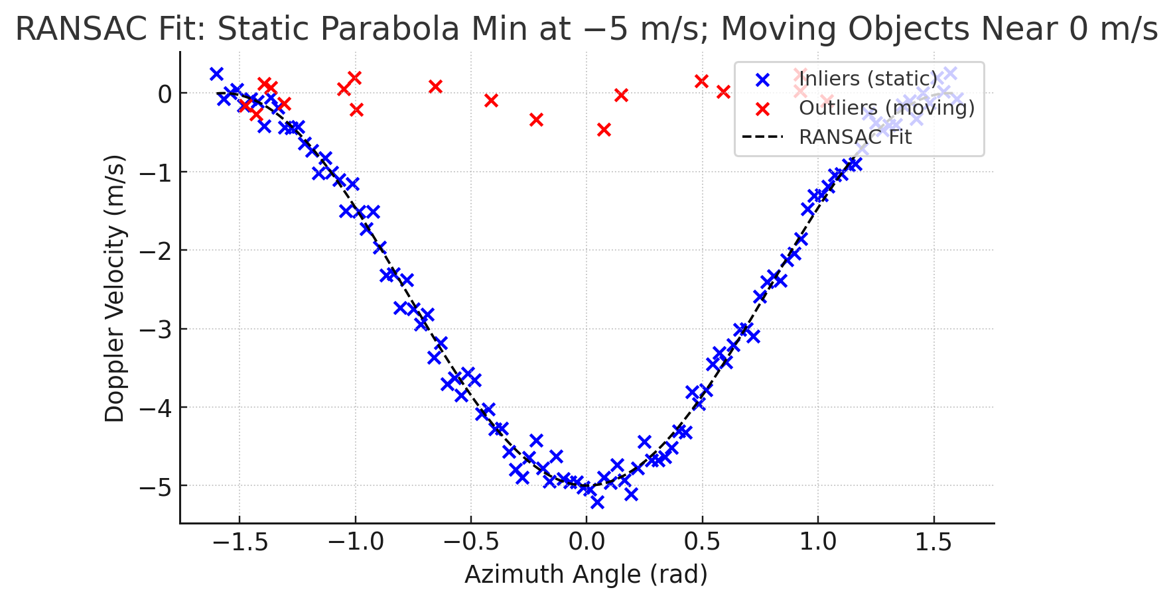
Method Overview Robust Point Selection
Fig 22, Idealistic case on how the RANSAC can classify dynamic vs static detections.

Slide 26
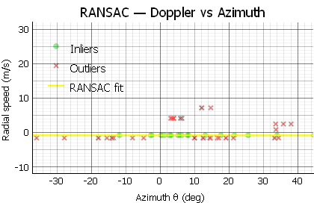
Method Overview Robust Point Selection
Fig 23, Realistic classification of dynamic detections vs static detections in this project.

Slide 27
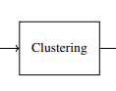
Method Overview Clustering
Clustering: DBSCAN, Groups neighboring points to form environmental features.
Great for finding geometrical patterns.
Fig 24, Highlight of the pipeline Clustering method and cluster tracking.

Slide 28
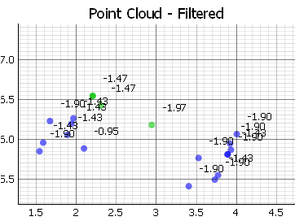
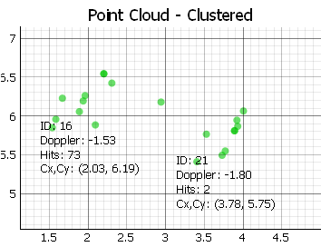
Method Overview Clustering
Fig 25.a, Raw data from the point cloud.
Fig 25.b, Clustered and tracked through time point cloud.
Fig 25, Showcase on the cluster tracking algorithm.

Slide 29
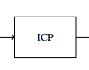
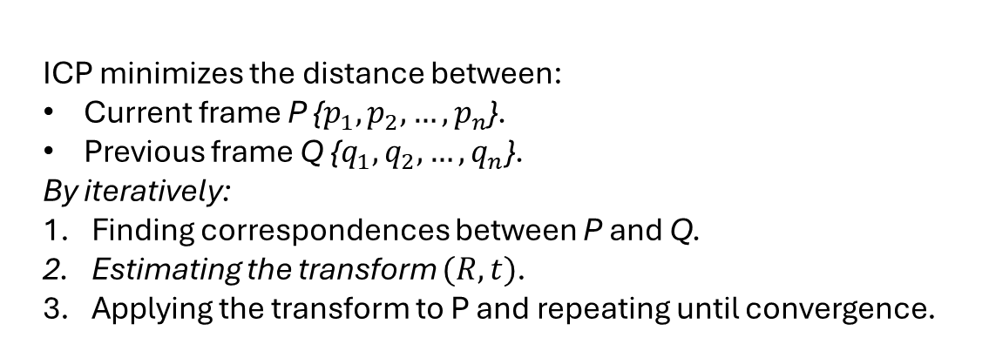
Method Overview Iterative Closest Point
Fig 26, Highlight of the Iterative Closest Point algorithm.

Slide 30
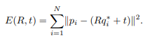
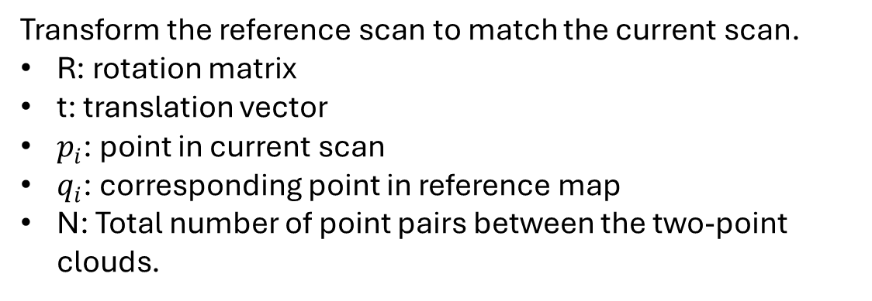
Method Overview Iterative Closest Point
Eq 4, Translation and Rotation equation from ICP algorithm.
Transform the reference scan to match the current scan.
R: rotation matrix
t: translation vector
$p_{i}$: point in current scan
$q_{i}$: corresponding point in reference map
N: Total number of point pairs between the two-point clouds.

Slide 31
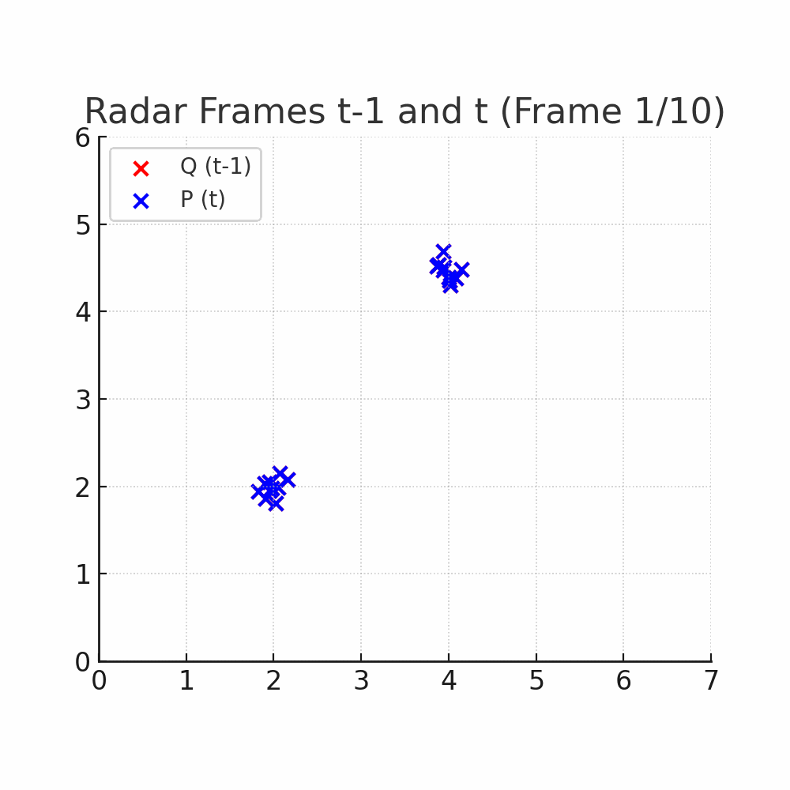
Method Overview Iterative Closest Point
Animation 4, Simulated data to show how the frames p and q correlate.

Slide 32
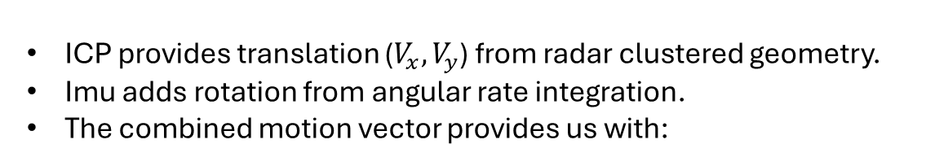
Method Overview Ego-Motion
The accumulation and sequential composition of these transforms gives us the odometry trajectory.
Fig 27, Highlight of the Ego-Motion estimation of the pipeline.

Slide 33

Method Overview Ego-Motion
Animation 5, Simulated data to show how ICP using p and q, provide a solution to obtain the vehicle ego-motion.

Slide 34


Method Overview Ego-Motion Laboratory
Fig 27.a, Full point cloud estimation.
Fig 27.b, Clustered point cloud estimation.
Fig 27, Ego-Motion estimation in a straight line, test done in the laboratory.

Slide 35


Method Overview Ego-Motion Laboratory
Fig 28.a, Full point cloud estimation.
Fig 28.b, Clustered point cloud estimation.
Fig 28, Ego-Motion estimation in a drive around maneuver, test done in the laboratory.

Slide 36


Method Overview Ego-Motion Hallway
Fig 29.a, Full point cloud estimation.
Fig 29.b, Clustered point cloud estimation.
Fig 29, Ego-Motion estimation in a forward drive, test done in the laboratory hallway.

Slide 37


Method Overview Ego-Motion Parking Lot
Fig 30.a, Full point cloud estimation.
Fig 30.b, Clustered point cloud estimation.
Fig 30, Ego-Motion estimation for a L-drive maneuver, test done in the FH-Dortmund parking lot.

Slide 38
Results and Discussion Comparison Between Full Point Cloud and Cluster-Based Odometry
Environment | Characteristics | Best Method | Explanation
Indoor Laboratory | Complex multipath. | Full Point Cloud | The abundance of reflections provides sufficient correspondences for robust matching, even without clear landmarks.
Outdoors Parking Lot | Sparse reflections. Clear large-scale landmarks. | Clustered-Focused | Stable clusters around static landmarks (e.g., walls, cars, curbs) allow more reliable ego-motion estimation despite lower point density.

Slide 39
Results and Discussion Comparison Between Full Point Cloud and Cluster-Based Odometry
Full point cloud ICP is robust in dense and reflective indoor environments but suffers from noise sensitivity outdoors.
Cluster-based ICP outperforms in structured, sparse environments where distinct landmarks dominate.
Fig 31.a, Indoors illustration with clustered and un-clustered solution.
Fig 31.b, Outdoors illustration with clustered and un-clustered solution.
Fig 31, Comparison of the Ego-Motion estimation between outdoors vs indoors.

Slide 40
Conclusion
The proposed mmWave + IMU fusion framework successfully demonstrated ego-motion estimation using dual radar sensors.
Results show that the environment type critically affects the two different ICP solutions performance:
In dense indoor environments, the global point cloud approach provides better stability due to the abundance of reflections.
In sparser outdoor scenes, the cluster-focused approach significantly improves accuracy by anchoring motion to static landmarks.
This confirms that mmWave radars can serve as a viable low-cost alternative for odometry in GPS-denied scenarios when complemented by inertial measurements.

Slide 41
Future Work
Improve the odometry visualization tool, as this create different results depending on how the slider is moved.
Implement rotation using radar-only.
Extend to 3D radar odometry and fuse with vision-based mapping for richer scene understanding.
Integrate loop-closure detection for long-term drift correction.
Extend the performance evaluation under adverse weather to confirm radar’s odometry environmental resilience.

Slide 42
Possible Applications Radar Ego-Motion
Vehicle ego-motion
Robust close-range (radar dependent) odometry for low-medium speeds.
Complement GNNS and vision in adverse conditions.
Radar-assisted ADAS.
Adds direct radial speed estimation to ADAS system.
Multi-radar drone tracking and handover
Distributed FMCW radar could provide persistent, multi-angle tracking of UAV´s.
Personnel / Crowd density and flow monitoring (privacy preserving)
Non-visual crowd analytics: density, direction, flow rate (speed).

Slide 43
Acknowledgments
Special thanks to:
Supervising Professor: Prof. Dr. Andreas Becker.
For his guidance, feedback, and continuous technical supervision throughout the project.
Co-Supervisor / Assistant: Tobias Uhlich.
For his support in radar data acquisition, experimental setup, and analysis.
External Contributor: Morten Nisov. [Norwegian University of Science and Technology (NTNU)]
For valuable discussions and assistance in solving technical challenges.
Collaborating Students: Igor Risteski [FH Dortmund].
For his help during radar calibration procedures and system testing sessions.

